Slide 1
JUMPSTART & JUNIOR PARENT MEETING

Slide 2
Welcome to Starskate Jumpstart and Junior Programming
Your skaters are currently on the Starskate Pathway in the learn-to-train level as part of the Sport for Life’s Long-term development
When logged into your account with Skate Canada you can read more on the Starskate Pathway
Go to skatecanada.ca/members to create an account in your child’s name. This way you will be able to see their STARskate Achievements and follow their official progress.

Slide 3
Assessments
Skaters at the Jumpstart level will complete their Canskate Badges while learning to figure skate. These are listed under achievements at the club level on our website.
Junior Skaters will start or be working on Star 1 – 2 assessments in dance, skills and freeskate. It takes a lot of practice to accomplish the skills in each area.
The Starskate assessments cost $12 per assessment which goes to Skate Canada.
Coaches will provide you with an envelope and instructions for returning once your skater is ready to take an assessment.
You need to purchase the assessment on-line and include the name of the tests in the comment section of your invoice – this is your receipt. Choose e-transfer if paying by cash include your invoice number on your envelope

Slide 4
Events
JUMPSTARTS
Can register for our club “Canskate Merit Event”
As part of Skate Canada’s long-term-development, these type of events get your skater ready for the learn-to-train at the Junior level.
Take advantage of any performance opportunity like our Holiday Performance Food Bank Drive
If your skater moves up to Junior, they will have other opportunities as well.
Join the Synchro Session on Sundays. As your skater does not have a regular jumpstart session this day, this will give them the opportunity to work and develop their skating skills while having fun learning on a team. More on synchro later…..

Slide 5
Events
JUNIORS
We encourage all skaters at this level to participate in appropriate level events that are offered to further their development and prepares the skater for choosing skating pathways
They may not know at this time if they want to be a podium pathway skater and try out for Canada Games or Nationals. Preparing leaves these options open.
Events this season:
2024 Fall Skate Invitational – Cody Banks Arena – Registration opens Oct 12 – 19 STAR 1 – 4 Events
2025 ADL Starskate Competition – Event is Feb 22, 2025
Synchro Events also on island are the Fall Invitational & the Friendship Competition in January
Skaters may also go to off-island events. There are opportunities close by in NB & NS. SPSC offers funding of $100 for one off-island event

Slide 6
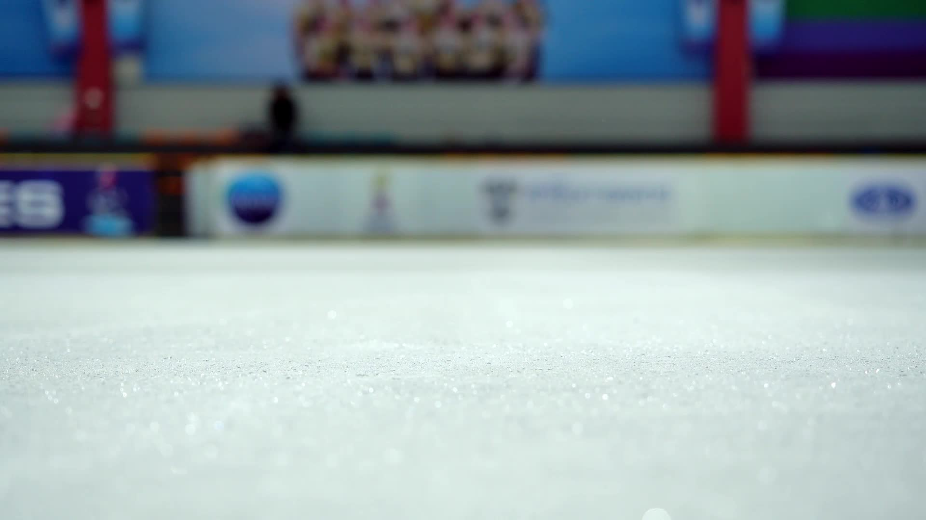
Competition Hosts
Sherwood Parkdale Skating Club is part of the Island Skating Academy for programs in the off-season.
We will be hosting the 2024 PEI Fall INVITATIONAL as well as the 2025 Starskate and Synchro Championships with Skate Canada PEI.
For the Fall Competition we have more responsibilities and duties to cover as volunteers.
COLLEEN MURRAY WILL BE OUR Coordinator WITH isa and will be the lead for our club along with Laurie Godfrey (for ISA &the PEI Section). CSC WILL HAVE A representative AS WELL AS PART OF isa
more INFORMATION ON HOW YOU CAN HELP WILL BE PROVIDED AFTER isa MEETS

Slide 7
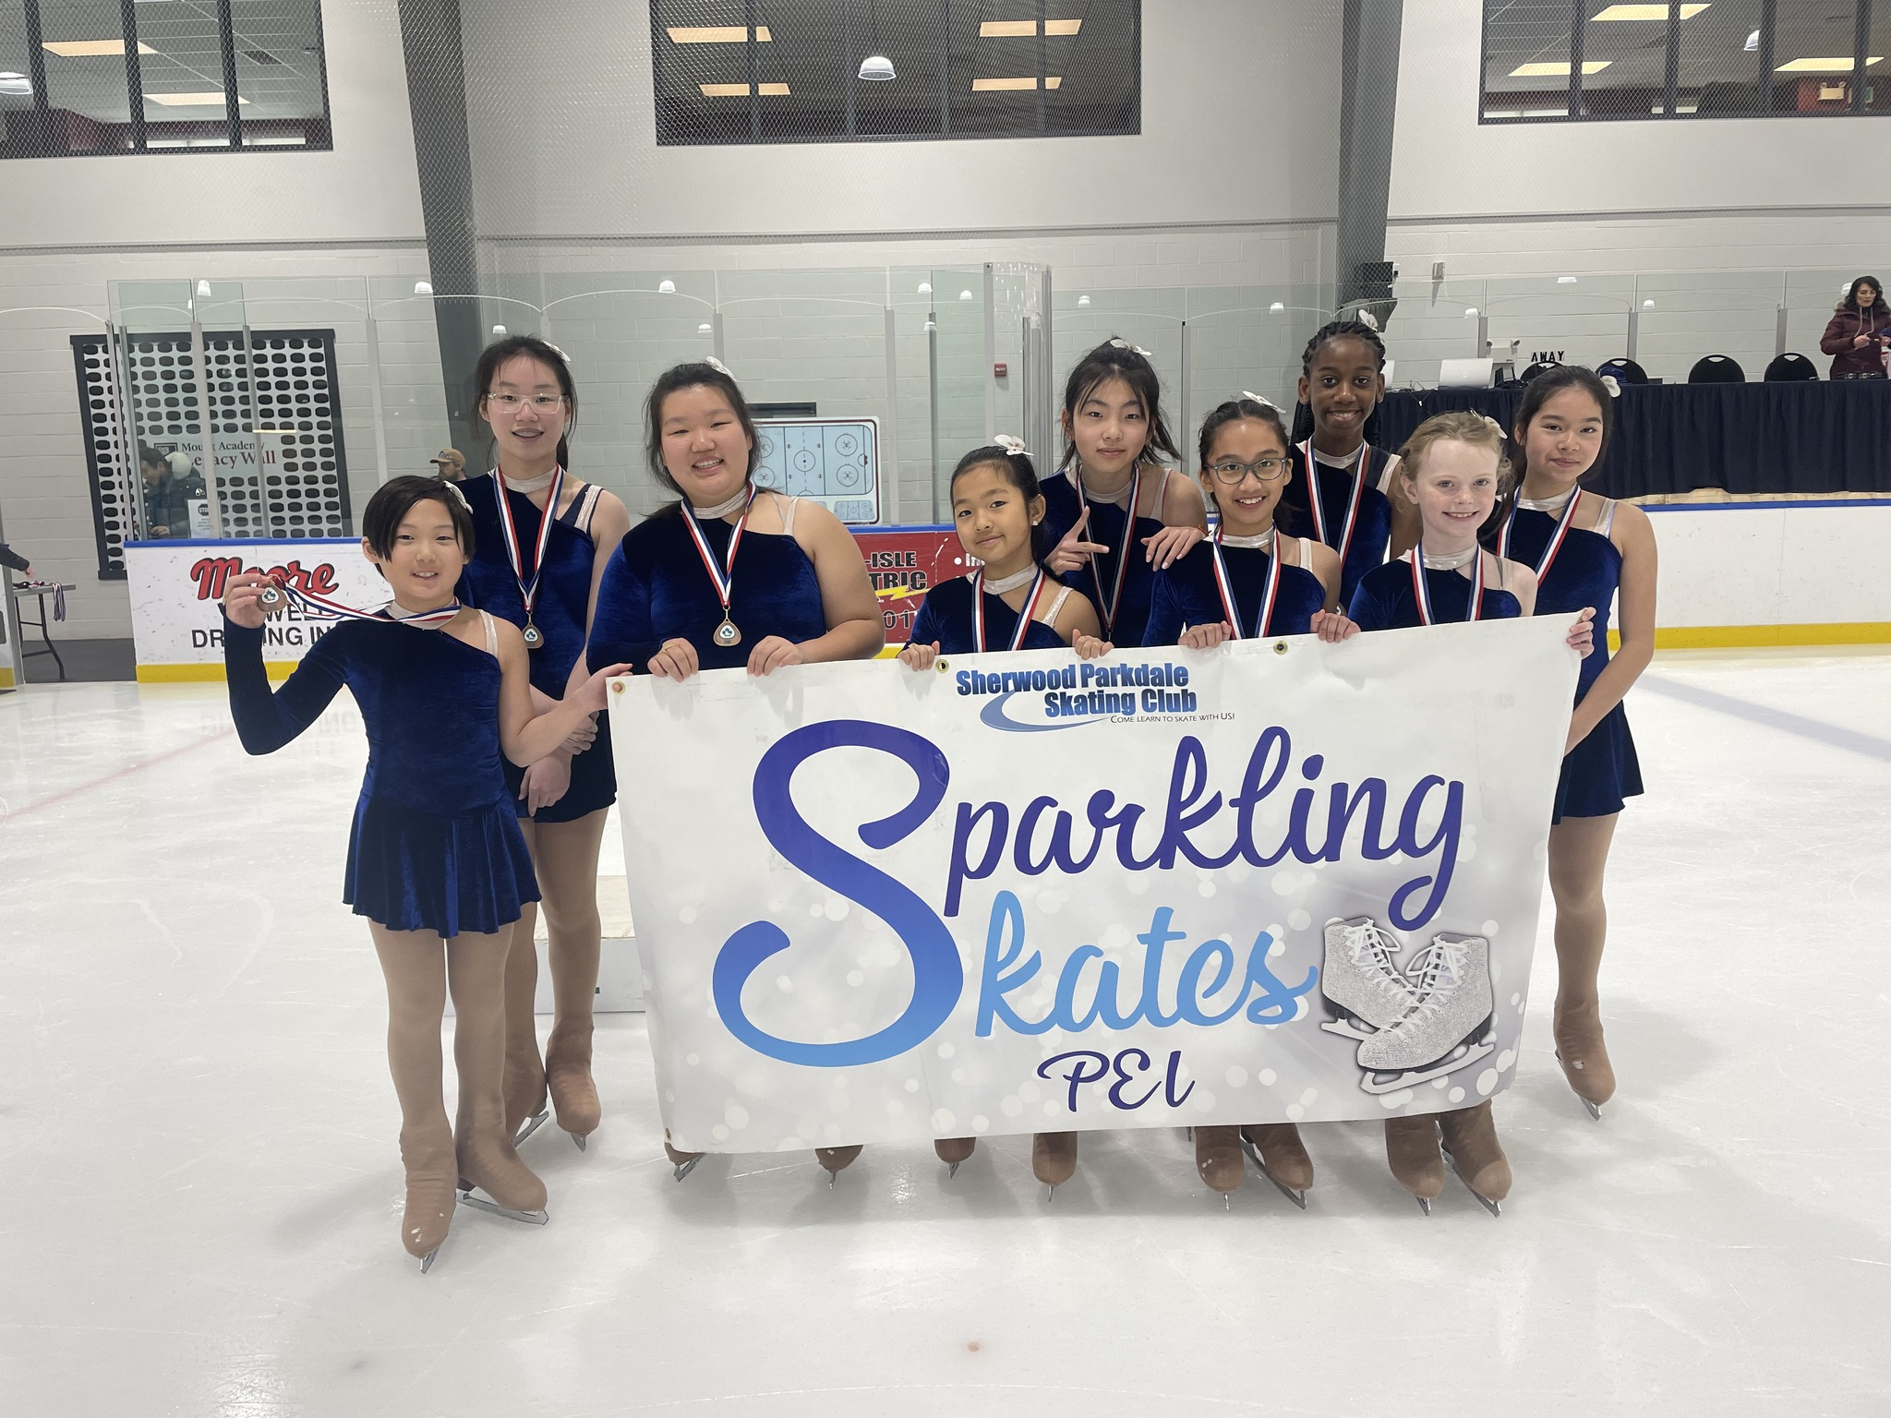
Synchro
All STARSkaters are encouraged to take part in Synchro
As part of the Skate Canada curriculum, this session is an excellent opportunity to develop skating skills
For the skater’s this is a great opportunity to engage in a team environment
The cost is $150 as an add-on to a Starskate Registration or we have a new part-time package.
BOTH include ice time, coaching, off-ice classes, the Team portion of competition registration fees
New team members will also receive a free Sychro Jacket
Toonie Days from September, popcorn sales at events plus any agreed upon fundraising goes into our Synchro fund to help off-set costs

Slide 8
Healthy Kids! Active Kids! Fundraiser
This season the fundraiser WILL BE PARTNERED WITH QUEEN STREET MEAT MARKET IN CHARLOTTETOWN
FUNDRAISING POLICY
If you want to fill your freezers and you purchase more than 10 items, you will receive a credit on your personal account as well as helping the club overall.
Hard copies and digital copies will be available
This is our main fundraiser for the club that puts food on tables at better than or equal to grocery store prices while helping the club keep fees affordable.

Slide 9
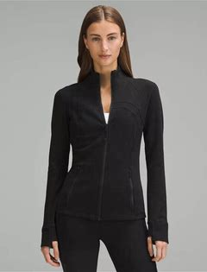
Team spirit
Club jackets are available to order. Your orders are Due by October 4th
Lululemon define jackets embroidered with the club logo and skaters Name or initials. Start at size 0
Great for both practice and competition
Youth sized are available by special order in a Lulu style jacket
Your cost: Lululemon $60 – 100 dependant on discount available: youth custom $40

Slide 10
How can you help your skater succeed
Encourage personal growth
Not to compare themselves with other skaters but use each other to motivate and support sportsmanship
Encourage proper etiquette on the ice. Respecting everyone’s right to train and not disrupt practice
Use their training time to the fullest
Recognize that there are entry levels throughout the stages of figure skating. Believe in themselves
Healthy Eating
Take advantage of opportunities outside of regular ice and off-ice times

Slide 11
NUTRITION

Slide 12
Terms and conditions
Signed when registering
You can also view by clicking on the link at the bottom of our home page

Slide 13
Key areas to review in your Terms and conditions
Policy links under Code of Conduct
Refunds & Credits
PA Incentive under Volunteers
Cancelations
If you haven’t reviewed, how can you follow?
Medical only once we are past the withdrawal date
No make-up or refunds for personal reasons ie holidays etc
Review if skater is moving up to Juniors or your skater is 10yrs and older
Notifications

Slide 14
Program assistants AND THE STARSKATE PROGRAM
JUMPSTART
JUNIORS
PA INCENTIVE KEEPS COSTS DOWN
DID YOU KNOW YOUR PROGRAM ACTUALLY COSTS 3 TIMES AS MUCH AS WE CHARGE?
WE CAN DO THIS BY HAVING PROGRAM ASSISTANTS
WHO ARE OUR PA’S
JUNIORS & INTERMEDIATES 10YRS OF AGE AND OLDER
SENIORS OF ANY AGE

Slide 15
Lead by example
Our club….Your Club….is a community.
Starskaters assist as program assistants on Canskate
We need you, the adults also. You can sit on the board and learn more about your childs sport and program, you can help at events, you can help on theme days. Consider joining us today in anyway you can.

Slide 16
Reminders
THE CALENDAR tab in your account
will show all your registered skating days, events etc.
This is the best “go-to”. It the event of any changes, it will show here first.
Off-ice classes are included in your registration and an important part of a skater’s training. If possible ,please bring a yoga mat, skipping rope, running shoes and a water bottle. A “spinner” is also very useful.

Slide 17
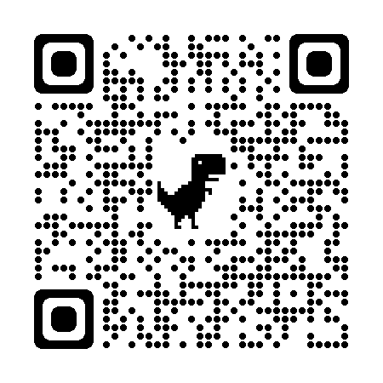
Club Apparel
We have a store available through Allstar Cresting
There are leggings, t-shirts, hoodies, outdoor jackets and more – Get in the spirit with quality merchandise. 10% goes to the club.
https://allstarcresting.ca/
Mittens and gloves as well as skate guards are also still available in our club office or lobby when on display

